Slide 1


SAP UI5 & FIORI with OData TRAINING using BAS
Anubhav Oberoy
Day – 3

Slide 2

Agenda – Day 3
Introduction to UI5
Responsive Web Design
Structure of UI5 Framework
MVC Architecture.
Project Structure of UI5 Project.
First UI5 Project

Slide 3

Introduction to jQuery
jQuery is a java script library, which is used to simplify our JS code.
The moto is to minimize JS code size.
Why we use jQuery?
It’s free to use (Open Source)
Used by top software companies like google, Netflix, etc.
Light weight JS library
jQuery greatly simplifies JavaScript programming.
Available on internet
Purpose is to write less and do more
Industry standard
How to use?
Download the jQuery library and keep it in our project, just like we use util/mycode.js
Reference jQuery from CDN (Content Distribution/Delivery Network) – directly reference it from internet
Documentation of jQuery is available @ https://jquery.com

Slide 4
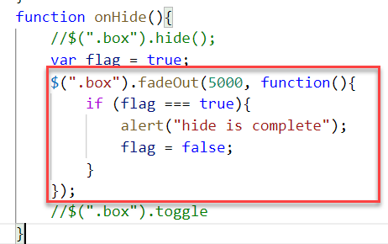
Syntax of jQuery
The jQuery syntax is tailor-made for selecting HTML elements and performing some action on the element(s).
Basic syntax is:
$(selector).action()
$ sign indicated to the browser that we want to use jQuery.
selector: selector is same what we have seen in CSS i.e., #id, .class, tagName
Action(): It is a JavaScript Event or Action which we want to perform on the selected element.
Example:
$("p").hide() - hides all <p> elements.
$(".test").hide() - hides all elements with class="test".
$("#test").hide() - hides the element with id="test".

Slide 5
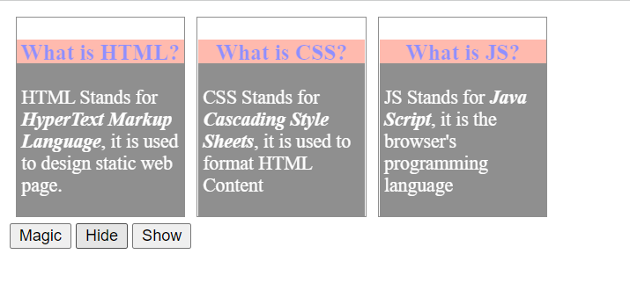
Hands – on: Adding effects using jQuery
Create a new file named jQBasic.html in the Basics folder which we have used for html, css and JavaScript.
Bring the code related to the box and box-content form the previous example.
Now we will add some effects to these boxes using the jQuery actions.
Code Link:
jQBasics.html

Slide 6
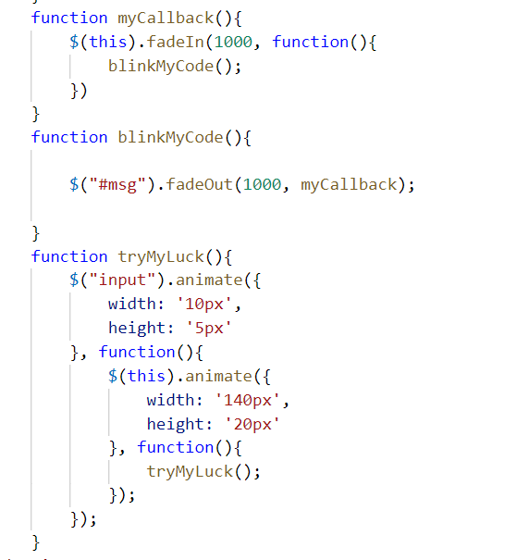
Hands – on: Adding Animation
Now we will add some animations to our html page using the jQuery.
For this we have to bring back the login fields code back form the previous examples.
Code Link:
jQBasics.html

Slide 7

Introduction to UI5
SAPUI5 (SAP user interface for HTML5) or Open UI5 is a collection of libraries that you can use to build desktop and mobile applications that run in a browser. With the SAPUI5 JavaScript toolkit, you can create web applications using HTML5 web development standards.
SAP UI5 is a framework which is used to develop Responsive web applications to run on any platform, any browser and any OS.
Framework: - A framework is a platform for developing software applications. It provides a foundation on which software developers can build programs for a specific platform.
A framework consists of libraries that can be used to process input, manage hardware devices, and interact with system software.
Library: - A collection of Classes.
Classes: - Collection of methods, Attributes, Events.
Your Code
You call the library
Framework call you
Libraries
Framework
Contains

Slide 8

Responsive Web Design
Responsive web design (RWD) is a web development approach that creates dynamic changes to the appearance of a web application, depending on the screen size and orientation of the device being used to view it.
Responsive Web Design is about using HTML and CSS to automatically resize, hide, shrink, or enlarge a website to make it look good on all devices (desktops, tablets, and phones).
Now a days, all the frameworks are designed to adapt the UI according to the screen size of the device.

Slide 9
Structure of UI5 Framework
The UI5 framework is built on top of open standards like HTML5, CSS, JS, and jQuery. UI5 Framework composed of two major components.
1.Design Time Components: It helps us to designing a new application from scratch , it consists of lots of libraries which help to design our application.
2. Runtime Components: It consists of the renderer which is helpful for the conversion of ui5 code into the browser friendly code(HTML+CSS+JS)
The Browser only Understand the HTML , CSS , JavaScript.
BAS or VS Code
App
Creating a App
Using the Libraries
The Runtime component converts the code of application to
SAP UI5 Design Time Component
SAPUI5 Runtime Component
HTML+CSS+JS
sap.m
sap.ui.comp
sap.ui.table
sap.ui.layout
Renderer
sap.ui.core
sap.ui.unified
sap.ui.core.mvc
The browser will now understand the code.
HTML5
CSS
JS
jQuery
Browser

Slide 10
MVC Architecture
MVC Stands for Model , View and Controller.
MVC is a design pattern used in software industries to build applications.
1. Model: It holds the data of the application inside itself.
2. View: It is the output and input interface of the application or can say it is the user interface .
3. Controller : It has all the processing logic inside itself (all written in JavaScript).
The Controller has a event handler to handle the triggered event
eventHandler()
Controller
[Processing]
All processing logic is written in JavaScript because browser only understand JavaScript.
Model will notify the controller back again with the data.
If the event need the data it request the model for the data
The View Triggers a event to the controller.
<<Event>>
The controller get the data and notifies the view back
If we want direct interaction between view and model we use data binding
Model
[Data]
View
I/O
Data Binding
User

Slide 11
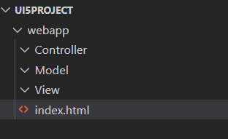
Project Structure of UI5 Project
When you create a new SAPUI5 application, you will be able to see a folder structure created in your project explorer like below.
In a SAP project there are a number of folders and files that you will not recognize if you are not familiar with MVC. Let's have a quick overview.
Within a given project inside the webapp folder , you have three core folders
Model
View
Controller
webapp folder : webapp folder is the root folder of the application in which all the core folders and files of the application were kept.

Slide 12
First UI5 Project in VS Code
Pre-requisites:
We must have node.js v14 or above installed in our system.
We must have sap ui5 tooling installed in our system
npm install –g @ui5/cli (ui5 command line tool)
npm install –g @sap/ux-ui5 tooling (Fiori command tools)
Both are pre-installed in BAS (Business Application Studio)
App creation:-
Initialize a UI5 project , Create a Folder for your project (UI5project) .
We need to create a webapp folder inside our project folder.
inside webapp folder create a manifest.json file
inside manifest.json file create “sap.app”
{
“sap.app”:{
“id”: “mickey”
} }
Now Initialize a node project , In the project terminal run command npm init (auto generate a package.json file).
Now run ui5 init command inside the terminal (ui5.yaml file will generated automatically)
Id is the identifier of the project.
You can give any name as a pet name of the webapp folder

Slide 13
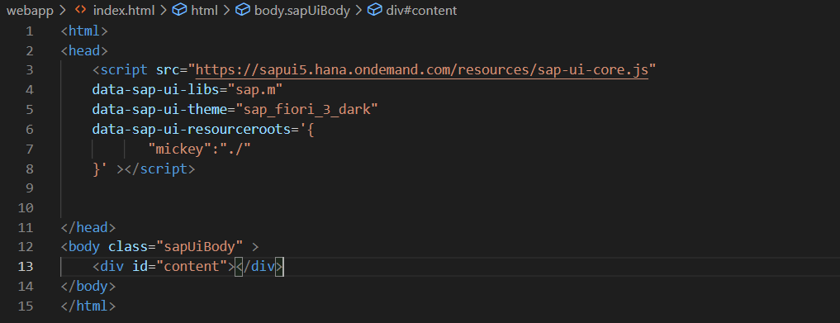
First App Continues……
App-Code:-
Create index.html , load the sapui5 framework from CDN and specify the properties like library and theme
Inside the terminal run command fiori run --open index.html to run your application on the browser.
This is also know asUI5 Bootstrap Code used to initialize the UI5 Framework initially
Here we have to also mention the namespace of the application

Slide 14
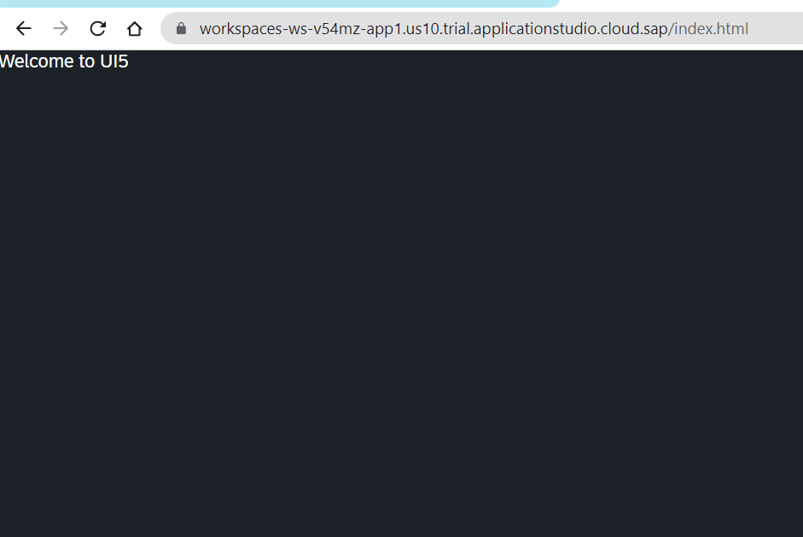
Hands on – Initialize first UI5 Project
Initialize a new ui5 project using the steps mentioned in the previous slide.
Code Link:-
index.html
manifest.json

Slide 15
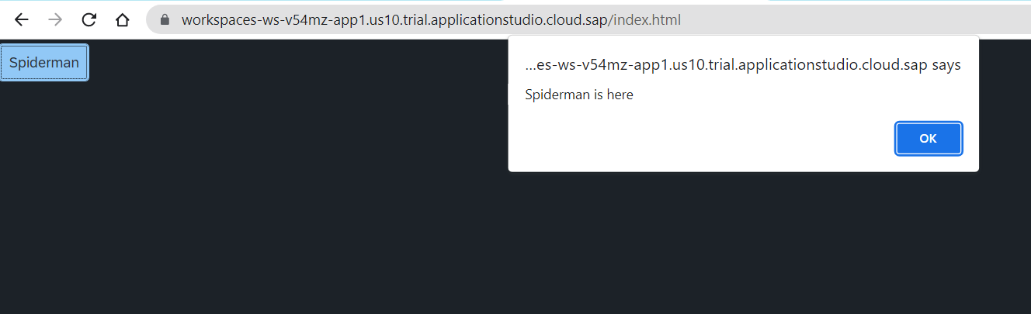
Hands – on: Create a Simple Button Control
Now we will add a simple button control to our app an on press of that button a alert message will be shown to the user, with message “Spiderman is here”.
Code Link:-
index.html

Slide 16
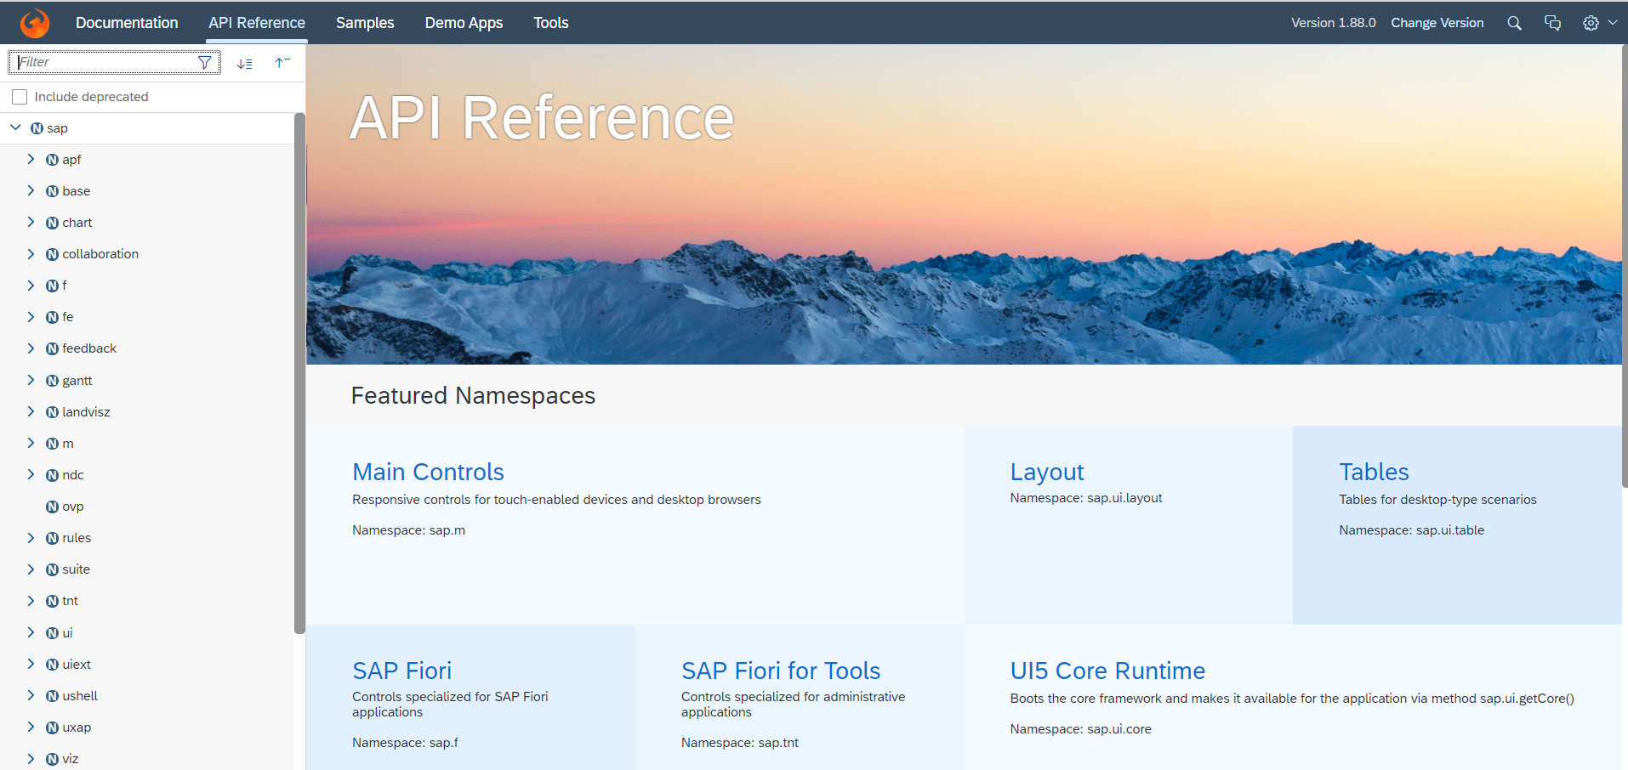
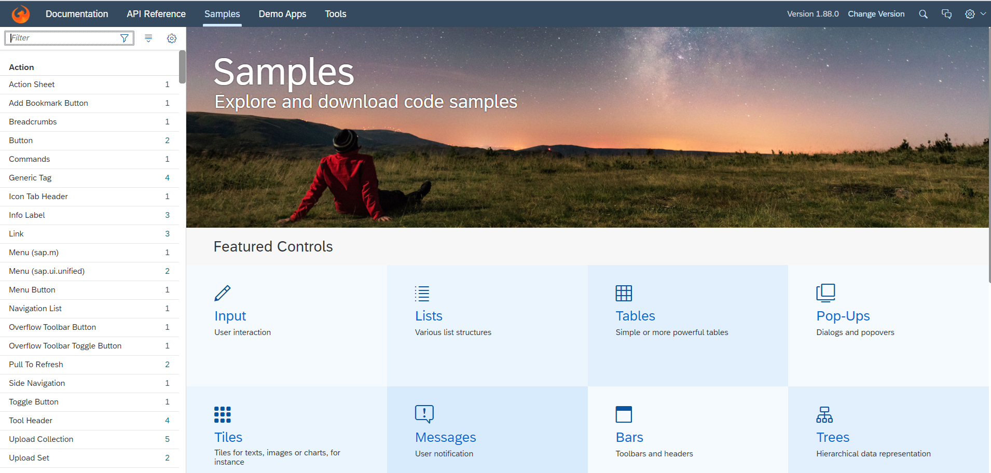
Introduction to UI5 SDK
Documentation of SAP UI5 is available at the SAPUI5 Software Development Kit.
We can access the SAP UI5 API’s at the Documentation page of SAP UI5 or you can use the link to go to sap’s API screen - https://sapui5.hana.ondemand.com/#/api
We can directly search the required api’s on the SDK.
SDK contains the sample of all the controls which we can use in UI5
SAP UI5 API reference screen
SAP UI5 Sample reference screen

Slide 17
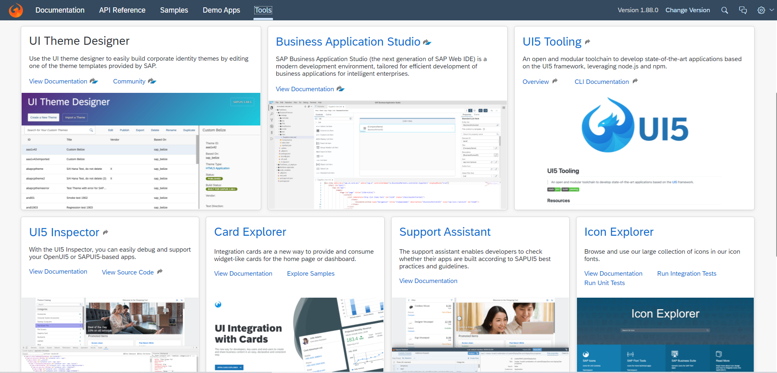
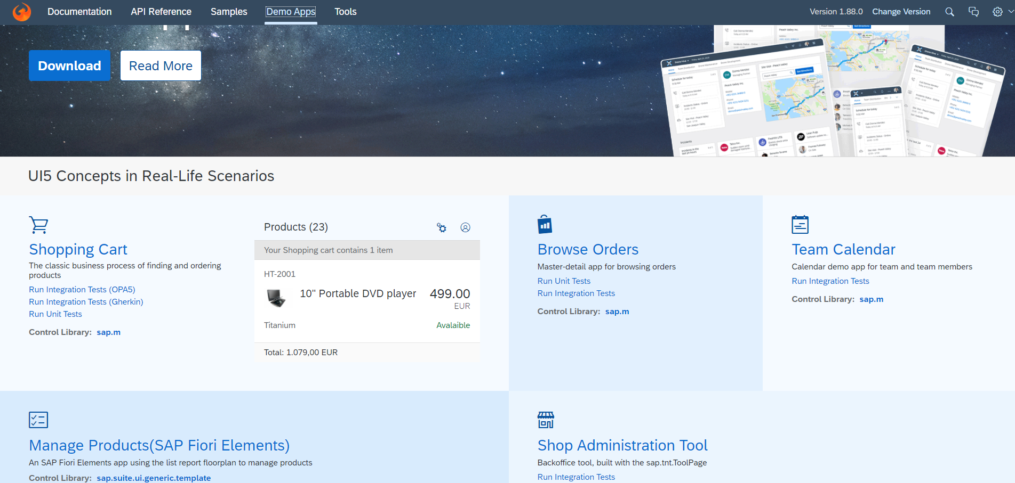
UI5 SDK continues…
UI5 SDK contains tools to make the development smooth for the developers.
It has UI5 icon packs which can be directly accessed for the UI5 SDK’s Tool Screen (Link).
SAP UI5 SDK provides us the demo application, So we can get an idea about how to create different type of applications using UI5 controls
UI5 SDK Tools Screen
UI5 SDK Demo Apps Screen

Slide 18
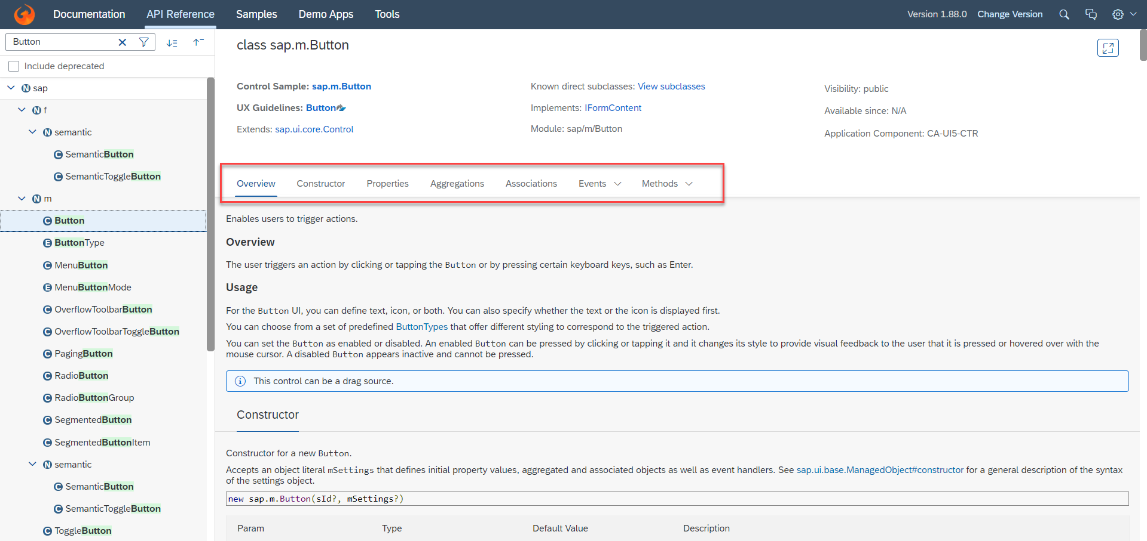
UI5 SDK continues…
When we search and open any API we see a screen similar to one which is shown below.
Every API contains different kind of:
Properties,
Aggregations,
Associations,
Events,
Methods

Slide 19
What is XML
What is XML?
XML stands for eXtensible Markup Language, it was originally developed to move data from one to another technology. It became popular to communicate between heterogeneous technologies.
XML is a tree data structure. Unlike HTML, we can use custom tags. Every programming language must support XML.
Portal
Java
App
ABAP
If_ixml
xml
xml
Data Objects → XML – Rendering
XML → Data Object – Parsing
Why XML View is better than other Views?
It is industry Standard.
XML handles the control id properly
XML rendering is faster
XML properly follows the MVC
Architecture.

Slide 20

End of Day 4

Slide 21

Questions

Slide 22

Anubhav Oberoy

Slide 23


We’re committed to empower you to be
Most Desirable Resource
through powerful training solutions.
We build the workforce of the future.
250+
Corporate Clients
30,000+
Learners Trained
25000+
Learners Placed
FREE WEBINARS
Sign up for free webinars with industry experts every fortnight!
Enroll Now!
Contact us today!
https://anubhavtrainings.com/

Slide 24




More from AnubhavTrainings.com

Slide 25
Title
Content

